Slide 1

Live Session Assignment Unit 14
6371-Statistical Foundation for Data Science
By-Rashmi Patel

Slide 2
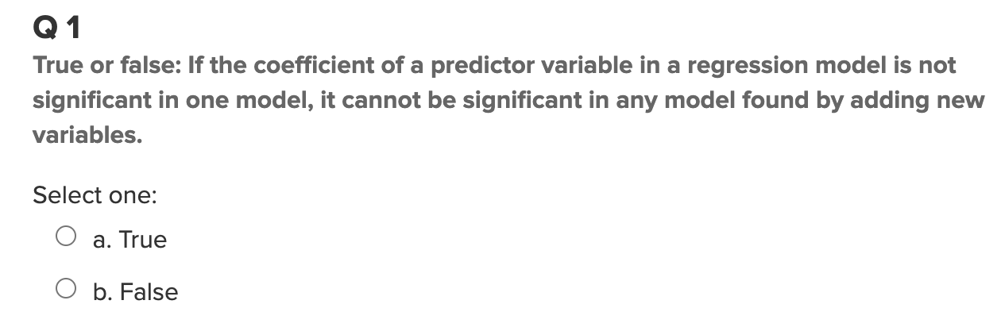
Live Session Assignment Unit 14
False

Slide 3
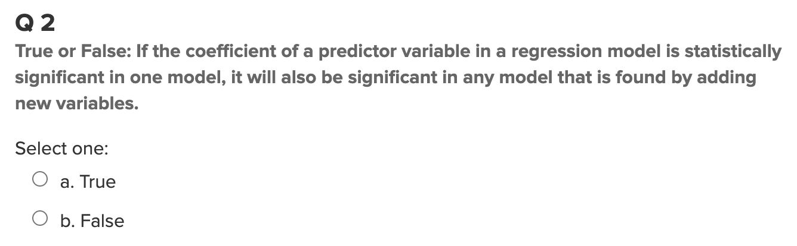
Live Session Assignment Unit 14
False

Slide 4
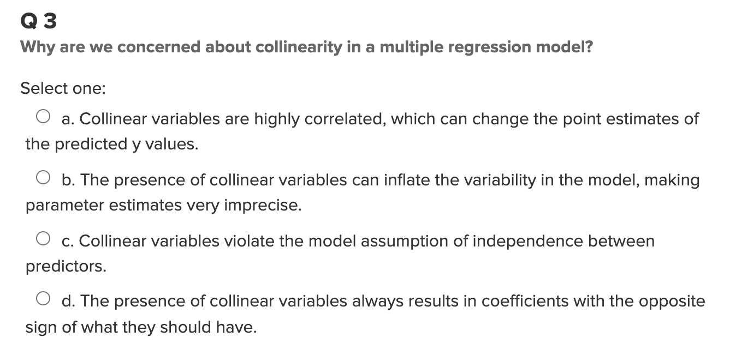
Live Session Assignment Unit 14
Option B

Slide 5
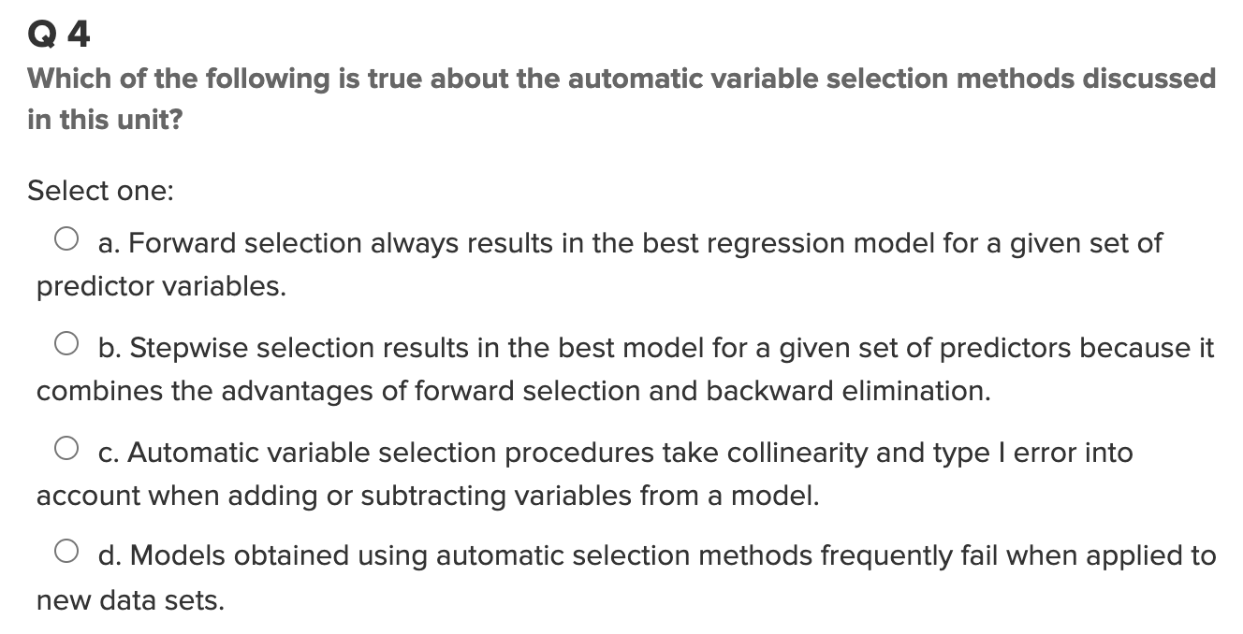
Live Session Assignment Unit 14
Option C

Slide 6
Live Session Assignment Unit 14.13.2
Cross Validation

Slide 7
Live Session Assignment Unit 14-Takeaways
In a multiple linear regression model, the parameter estimates are highly context dependent.
Magnitude of correlations depends on:
Range of values
Reliability of measurement
Type of participants included in study
Specific slope estimate depends on:Range of x and y scores
Type of participants in sample
Context of specific set of predictor variables
If we encounter an outlier, we should not delete it and move on with the analysis.
Regression analysis not resistant to outliers; some may be influential
Removing particular outliers may change parameter estimates
Outlier influence can be tested with measurements
DFFITS
Cook's distance
DFBetas
All measurement uses “leave one out” strategy.

Slide 8
Live Session Assignment Unit 14-Takeaways
Strategies for refining the model
Examine data for outliers and influential observations, and make decisions about them.
Remove terms that don't help answer the study questions; remove nuisance variables.
Use partial residual plots to determine influence.
Remove terms that do not have linear relationship.
Be aware that removing non-statistically significant term may change significance of other terms.
Check the model after every change.
Strategies for Numerous Outliers or Nonconstant Variance
Weighted least squares
Weights values with large variants less than values with small variants
Measurement error models
Appropriate when X is measured with error as well as Y
Not an issue if the purpose is prediction.

